Slide 1
Kaarle Nordenstreng:
How BRICS pushes to change the conventional paradigms in communication studies
Power shifts shaking research paradigms
Keynote in ICA pre-conference
“The BRICS Nations: Between National Identity and Global Citizenship”
London, 17 June 2013

Slide 2
Media Systems in Flux: The Challenge of the BRICS Countries
Project financed by the Academy of Finland and hosted at the University of Tampere
http://uta.fi/cmt/tutkimus/BRICS.html

Slide 3
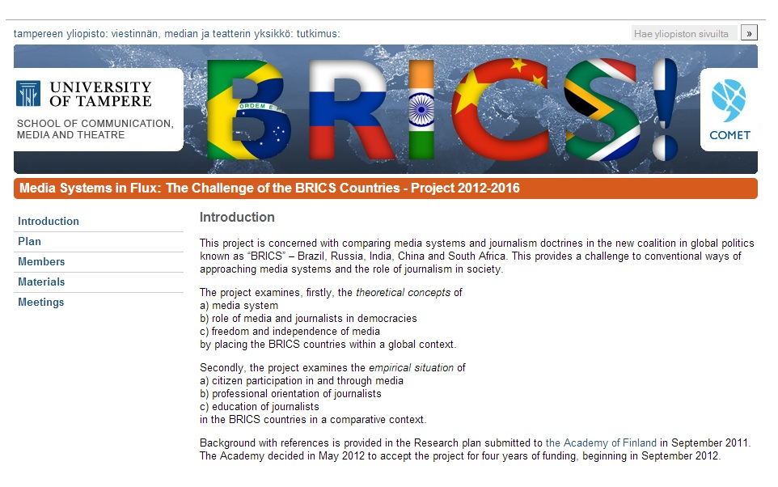

Slide 4
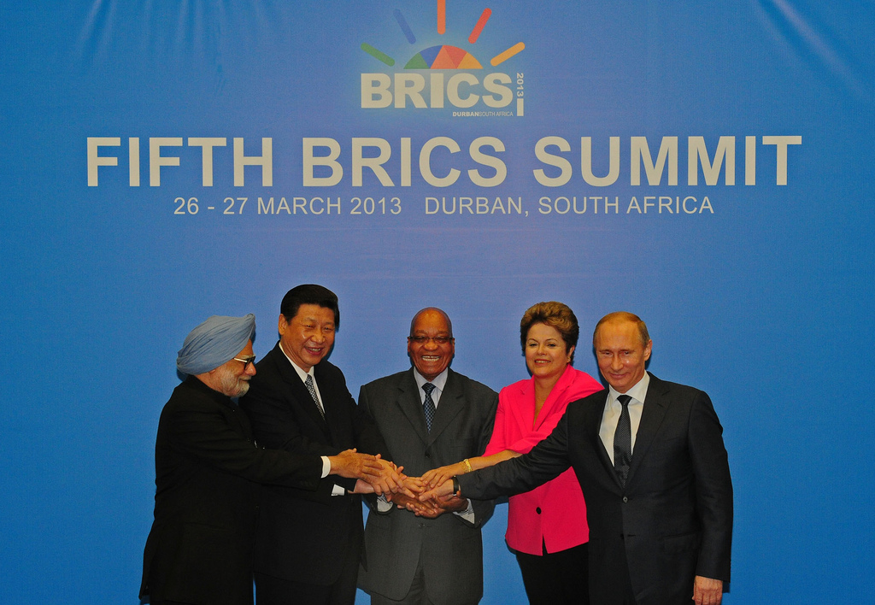
http://farm9.staticflickr.com/8405/8612243595_5461abde09_b.jpg

Slide 5
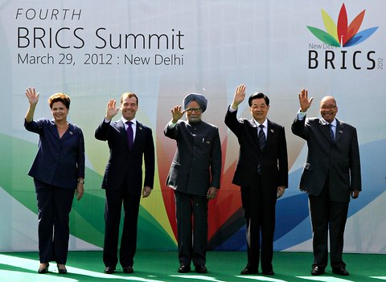

Slide 6
BRICS Summits
5. Durban (South Africa) 2013 http://www.brics5.co.za/
4. Delhi (India) 2012
3. Sanya (China) 2011
2. Brasilia (Brazil) 2010
1. Yekaterinburg (Russia) 2009

Slide 9
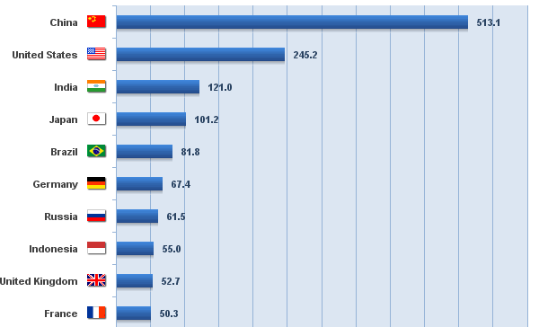
Top ten Internet users, in millions

Slide 10
Intellectual history of the field
Stages from 1950 to 2010
Dominant paradigm of modernity
Dependency paradigm of anti-imperialism
Multiplicity and participatory paradigm of democracy
Networking paradigm of globalization
Samples from each stage…

Slide 11
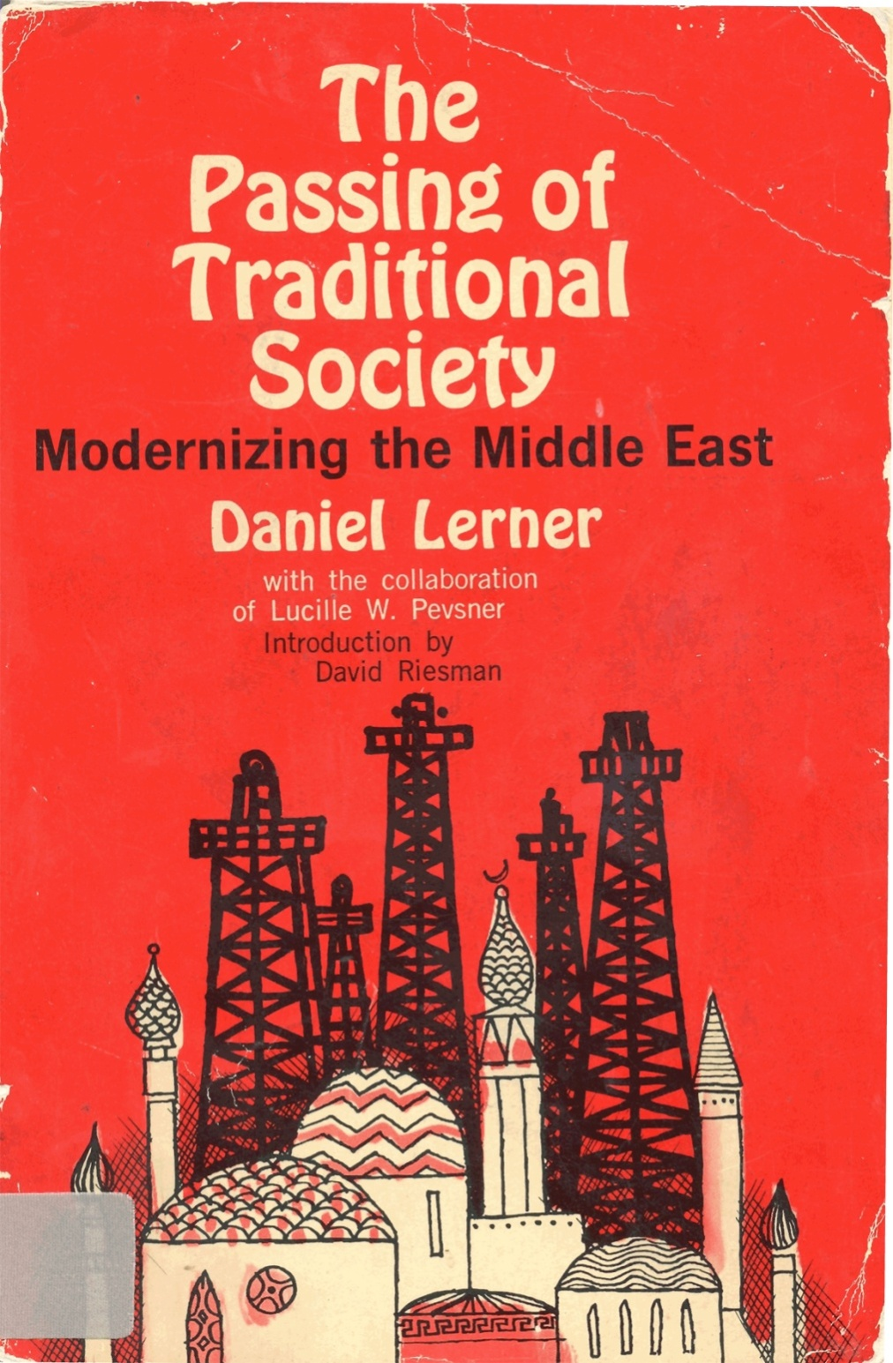

Slide 12
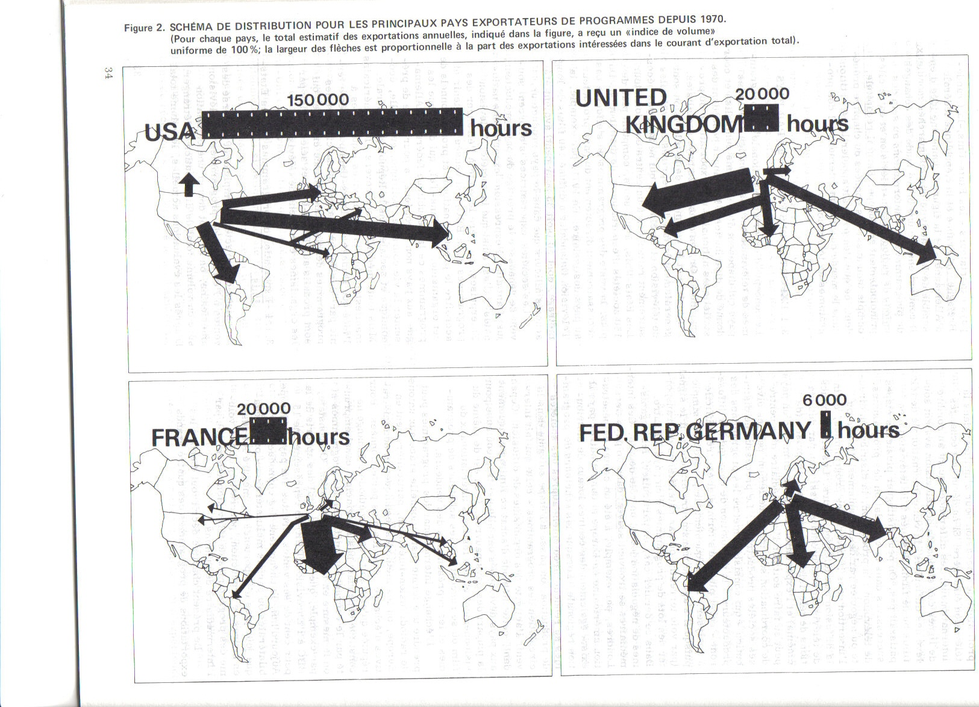

Slide 13
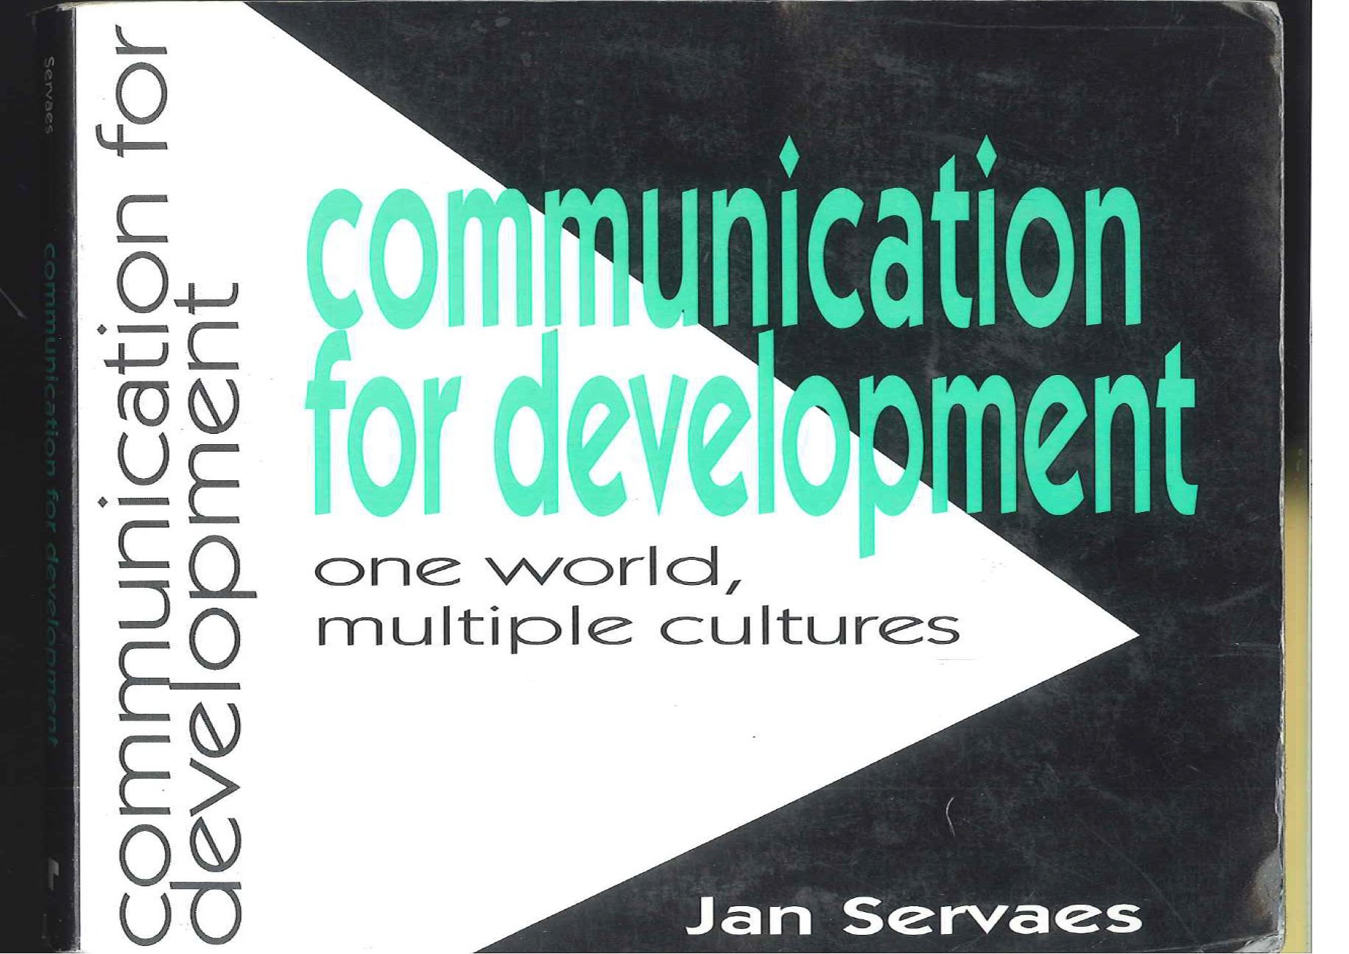

Slide 14
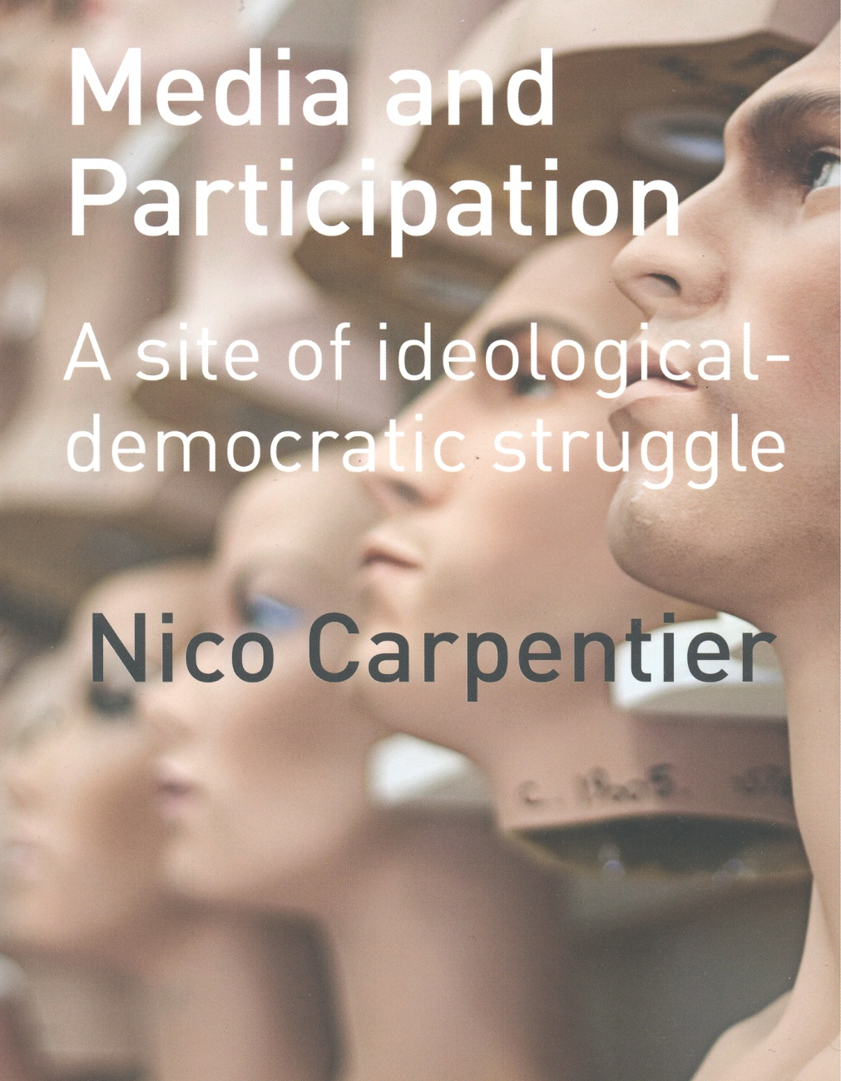

Slide 15
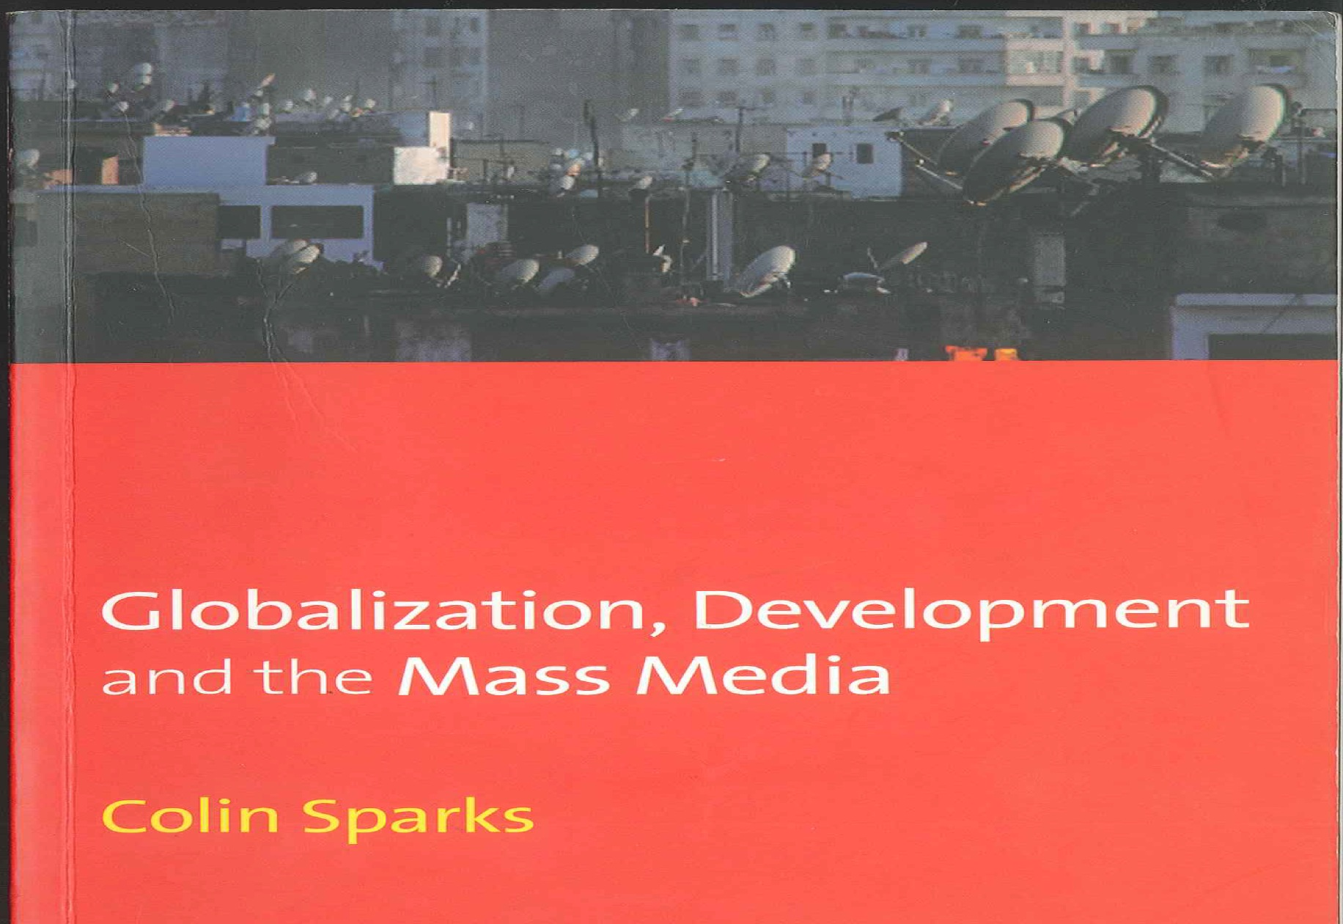

Slide 16
Current scholarship
G. Wang (ed.) (2011) De-Westernizing Communication Research. Altering Questions and Changing Frameworks
D. Hallin & P. Mancini (eds.) (2012) Comparing Media Systems Beyond the Western World
K. Bruhn Jensen & R. Neuman et al. (2013) Communication as a Discipline – Views from Europe. Evolving Paradigms of Communication Research. International Journal of Comm. 7

Slide 17
Power configurations behind the intellectual history
Cold War 1950-1990: East – West – South
Collapse of Communism 1989-1991
USA economically & militarily superior
European integration & growth
Asian economic growth
Rise of Islam in Asia, Africa & Arab world
Crisis of capitalism
Neo-liberalism at crossroads

Slide 18
Personal stories within the intellectual history
Progressive Americans such as Herbert Schiller and perestroika in Gorbachev’s USSR
Russians such as Yassen Zassoursky responding to perestroika
My own story: from mainstream positivist to
– ontological realist & new left activist in 1970s
– fellow traveller of the USSR in 1980s
– radical structuralist in 1990s

Slide 19
The push of BRICS
Compels our framework to be based on world order & political economy
Calls us to prefer de-westernization
Calls us to follow postcolonial traditions
Calls us to look for both comparisons and big meta stories
Invites our approach to BRICS itself to be critically reflective

Slide 20
Thank you!
kaarle.nordenstreng@uta.fi
http://www.uta.fi/cmt/en/contact/staff/kaarlenordenstreng/index.html

