Slide 1


Youth Participation in Internet Governance
ALL-YOUTH conference
23 November 2018
Jamal Shahin

Slide 2
Three propositions
Youth is problematic as a stakeholder group
Activity does not equal output
Policy makers look to youth for the future, not the present

Slide 3
Two recommendations
Choose the fights carefully - specific topics
Use the system to learn and build networks

Slide 4
Key words
What is internet governance?
Participation
Stakeholders

Slide 5
Key words
What spaces exist
Participation (What is it)
Stakeholders (Who are they?)

Slide 6
Part I Spaces for engagement

Slide 7
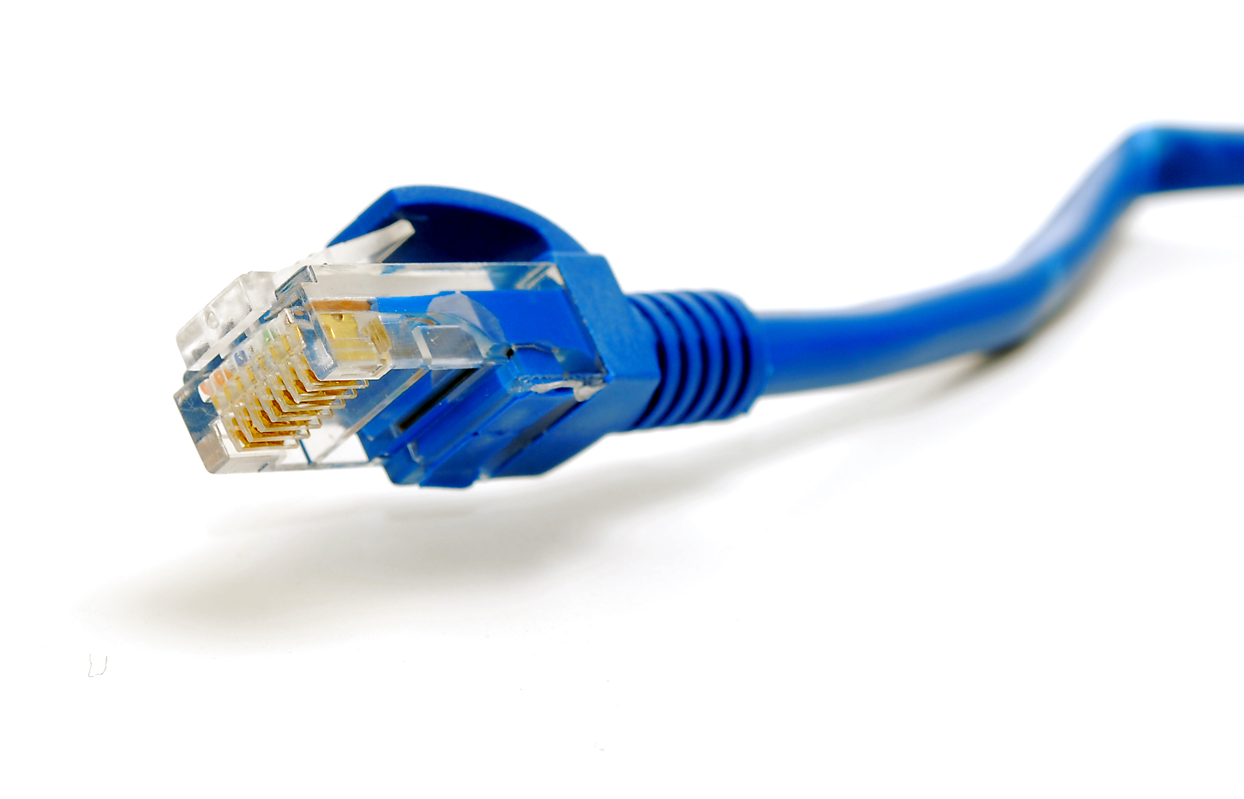
The importance of governing the internet
Internet as tool for economic development
Internet as core infrastructure for communication in society
Internet as a new global political space

Slide 8
The Internet’s Governance Landscape
ICANN
RIRs
IANA
gTLDs
ccTLDs
Governments
Governmental Regional Organizations
Multilateral Institutions
Internet Society
Chapters
Individual Members
Organization Members
Other Policy Discussion Forums
Other Standards Bodies
W3C .
ITU-T .
Specialized Bodies .
Internet Society Affiliated Organizations
IETF .
IAB .
IRTF .
Naming and Addressing
Local, National, Regional, and Global Policy Development
Open Standards Development
INTERNET
ECOSYSTEM
Governments
Internet Society
Chapters
Individual Members
Organization Members
Multilateral Institutions Development Agencies
Internet Community Organizations and Businesses
Universities and Academic Institutions
Shared Global Services and Operations
Education and Capacity Building
Root Servers
Network Operators
Service Creators/Vendors
Internet Exchange Points
gTLDs
ccTLDs
Users
Individuals
Businesses
Governments
Organizations
Machines/Devices
Service Creators and Equipment Builders
Notes:
The Internet’s governance landscape
This diagram shows the organizations and communities that have organically evolved to guide the operation and development of the technologies and infrastructure that comprise the global Internet.
These organizations share common values and a shared commitment to the open development of the Internet.
The multistakeholder model is a logical consequence of the Internet’s original design.
The Internet’s protocols and standards have been developed openly and transparently with everyone who wants to participate.
Stakeholders bring their expertise and enthusiasm and work collaboratively to deliver better outputs that can be implemented.
These stakeholders include the public and private sectors, academia, and civil society.
Because decision-making is consensus-driven, standards are voluntarily adopted.
The Internet’s multistakeholder approach drives innovation and economic stimulation. It contributes to the evolution of the Internet.

Slide 9



Multitudes of overlapping global institutions

Slide 10
Part II Participation

Slide 11
What is it?
Participation is…

Slide 12
What is it?
Participation is… active engagement in a process.

Slide 13
What is it?
Political participation is active engagement with the aim of making a specific policy change.

Slide 14
What is it?
Political participation can take place online or offline
Takes many forms and organised in many different ways

Slide 15
What is it?
Moving from passive participation to active (critical)
Especially in the youth sphere:
critical citizens
not bound to any specific political creed
self-expression logics
being more direct, creative and short-term
following non-institutional paths
targeting diverse actors

Slide 16
Prerequisites: Expertise and Knowledge

Slide 17
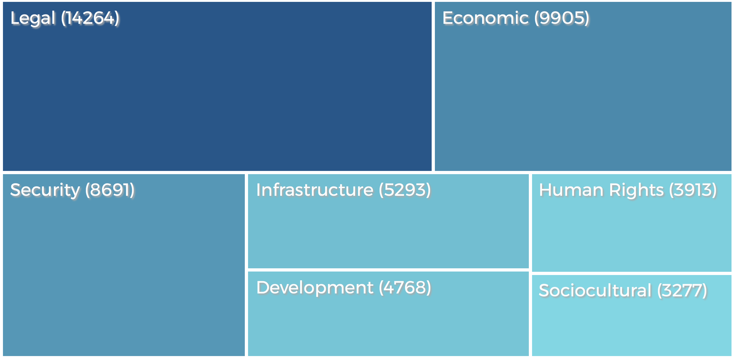

Slide 18


Slide 19
What do you think of when you hear the term "Internet Governance"?

Slide 20
Part III Stakeholders

Slide 21
Stakeholders
Who are the stakeholders?

Slide 22
Stakeholders
There are many!
Multistakeholderism is the term frequently used

Slide 23
Multistakeholderism
Bringing together of a variety of different stakeholders
Business, civil society, academia, governments
and Youth

Slide 24
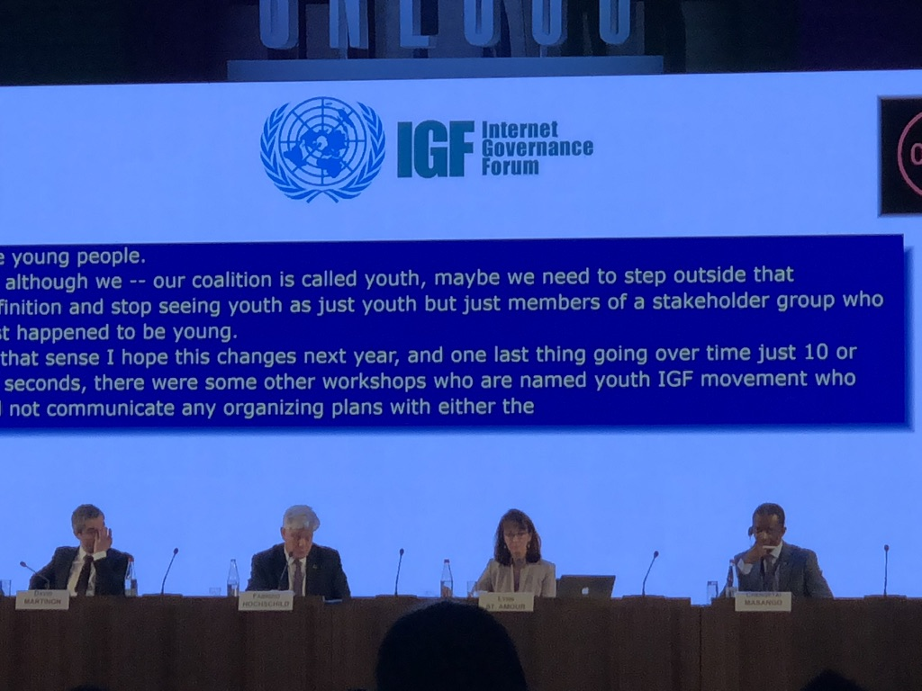

Slide 25
Three propositions
Youth is problematic as a stakeholder group
Activity does not equal output
Policy makers look to youth for the future, not the present

Slide 26
Two recommendations
Choose the fights carefully
Use the system to learn and build networks

