Slide 1
Understanding youth wellbeing in intersectional perspective
Ann Phoenix
Thomas Coram Research Unit

Slide 2
Finland 3.0 – All Youth Building Sustainable Well-being
Exciting promise of Finland 3.0 is better understanding of youth wellbeing.
To consider all young people, difference is a key issue in changing Finland (postmigrancy).
Intersectional theoretical frame reflects the complexity of everyday differences and commonalities in theory, research and practice.

Slide 3
Sanna Aaltonen (2018) ‘The good the bad and the quiet ones’, p.162
SA: Have you ever talked about sexual harassment at school.
Girl 1: Yes
Girl 2: From time to time during Finnish lessons. We discuss how dark-skinned people harass and then we always laugh at it. It would be terrible if there was a foreigner in our class and then we couldn’t talk about those kinds of things but there isn’t any.’

Slide 4
Intersectional approach: white Finnish “unmarked” perspectives (Aaltonen)
SA: Many girls told how boys grab their behind in a disco.
BOY: There are Russians and Somalis there that explains it.
SA: Oh?
BOY: No, well, no, Finns do that too but in general Russians have bad morality and many Somalis then, they believe they are real studs (p. 170)
c.f. O'Neill, Rachel. Seduction: men, masculinity and mediated intimacy. John Wiley & Sons, 2018.

Slide 5
Intersectional perspectives on young people’s wellbeing.
Outline of talk
Wellbeing and intersectionality
Capacities/Agency of young people & obstacles that hamper their engagement with society.
Children's intersectional negotiations of environment and computers.

Slide 6
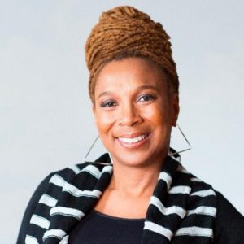
The Equal Rights Review, Vol. Sixteen (2016) pp. 210-211
Kimberlé Crenshaw: I think of intersectionality as a term that captures the fact that systems of oppression are not singular; they overlap and intersect in the same way that power does. …the understanding of any of these systems (e.g. race, class, gender) is rendered incomplete if little attention is paid to the ways in which sub-groups within larger groups experience subordinating structures…One thing that has been missing in the uptake of intersectionality is recognition that it is a relationship between identities – that is a social categorisation – and structures. Some talk about intersectionality solely as a marker of multiple identities and others talk about intersectionality solely in terms of structures. The point is that structures are made legible through their impact on particular people, and particular people are situated within these structures in marginalised and subordinated ways because of who they are seen to be. They are not separate …

Slide 7
Intersectionality approaches the complexity of everyday practices & identities
Disrupts additive or multiplicative models.
Categories as dynamic & mutually constitutive
Focus on inequalities as dynamic & not as properties of people.
Recognises multiple social positioning, intragroup differences & intergroup commonalities.
Focus on structural positioning and structure as non-determinist.
  Histories and everyday practices important.
Have to be viewed “… not as distinct but always permeated by other categories, fluid and changing, always in the process of being created by dynamics of power …” (Cho, Crenshaw and McCall, 2013, p.795)

Slide 8
Childhood wellbeing
‘There is some emerging consensus that childhood wellbeing is multi-dimensional, should include dimensions of physical, emotional and social wellbeing; should focus on the immediate lives of children but also consider their future lives; and should incorporate some subjective as well as objective measures.’ (Statham and Chase, 2010)
UNICEF domains: material; health & safety; education; peer and family relationships; behaviours and risks; subjective wellbeing.
Pollard and Lee (2003) Too often the focus is on children’s deficits, not what they can do.

Slide 9
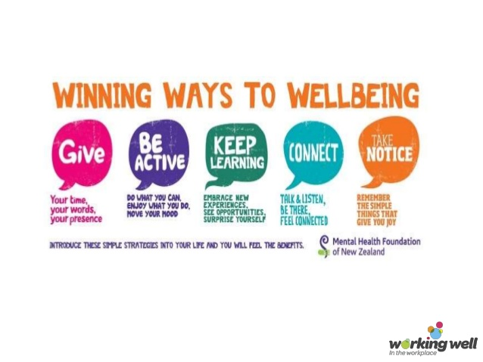
Wellbeing is a dynamic state
    Linked to a desirable health, social and educational outcomes, including optimal development (NEF, 2004).
Government Office for Science Foresight Report on Mental Capital and Wellbeing (2008) :
    Fulfil personal & social goals & achieve sense of purpose.
    ‘to develop their potential, work productively & creatively, build strong and positive relationships with others, & contribute to their community.’
    Education & learning as a route to wellbeing.
Five postcards (New Economics Foundation, 2008)

Slide 10
Intersectional perspectives on young people’s wellbeing.
Outline of talk
Wellbeing and intersectionality
Capacities/Agency of young people & obstacles that hamper their engagement with society.
Children's intersectional negotiations of environment and computers.

Slide 11
Deutsch &Theodorou (2010) US
Consumerism & consumption are central to young people’s identities.
Gender, race and social class mutually constitute each other.
Girls talk of aiming for financial independence (boys take this for granted)
Boys’ ethic of care include responsibility for future ‘dependents’, including mothers.
Constrained by socioeconomic status.

Slide 12



‘Acts’ of Global citizenship
Global connectedness, social justice and cosmopolitan perspectives
A global citizen is someone who identifies with being part of an emerging world community and whose actions contribute to building this community’s values and practices.
Ron Israel ,The Global Citizens Initiative
Knowledge, understanding, skills
James A. Banks, 21st century citizens ‘need the knowledge, attitude, and skills required to function within and beyond cultural communities and borders...students need to understand how life in their cultural communities and nations influences other nations and the effect that international events have on their daily lives.’
Empathy and ethics
Peggy McIntosh, ‘the idea of a global citizen with habits of the mind, heart, body, and soul that have to do with work for and preserving a network of relationship and connection across lines of difference and distinction, while keeping and deepening a sense of one’s own identity and integrity.’

Slide 13
Language brokering as a neglected example of global citizenship
Part of an emerging world community whose actions contribute to building community values and practices (Israel).
Knowledge and skills required to function within and beyond cultural communities and borders (Banks).
Empathy in preserving a network of relationship and connection across lines of difference and distinction (McIntosh).

Slide 14
Children’s language brokering gives young people valuable skills
Orellana (2009) how to listen; paraphrase meanings;
About employment, housing, shopping, medical care etc., (Dorner et al., 2007).
Children’s work helps to ensure that their parents can be good citizens, able to pay their taxes, obey the laws and maintain their employment and family lives.

Slide 15
Enabling global citizenship within and across international borders
Fong: And I remember at that time it was …when my mother was trying to petition her family, her two sisters and her brother over from China. … And you know, the (.) the entire immigration process is (.) is (.) takes a long, long time, I think I remember maybe it took ten years, the entire thing, … so I remember im- you know, translating immigration paperwork, calling immigration several times, um and (.) and being put on hold (laughs) several times for long periods of time. But I think having them arrive you know, you’re seeing the fruits of your labour, I think it’s (.) it’s kind of rewarding in that sense um but you know, didn’t see it for a long time ... that was a big project um I think some of the smaller projects were just you know, writing cheques and things like that.

Slide 16
Obstacles that hamper engagement with society
How children experience language brokering is contingent on
  context,
  their age,
  perceived competence
  how their brokering is received (Cline et al., 2011).
Constrained ability to be global citizens

Slide 17
Intersections of language, ethnicity, migration status & structural discrimination
Teachers underestimate the abilities of young people from linguistic minorities.
Deficit perspectives treat everyday language practices as ‘inferior’ to school practices.
Yet, important to build upon student practices, skills & understanding. (Jacqueline D’warte, 2014, 2018)

Slide 18
Teachers can be helped to recognise children’s competence
“I really got to know my students better and that really makes a difference to what we did in our classrooms. Now I realise that they have a vast array of skills that I hadn’t really thought about, that they are using language constantly and a mix of languages, and what surprised me was that they were using first, second and sometimes third languages in the home and that’s just amazing” (D’warte, 2014: 28)

Slide 19
Michelle Fine (2018) Just Research in Contentious Times (pp. 49-50)
“The young people most disrupted today by economic instability, housing and hunger insecurity, gentrification, mass incarceration, and immigration/ deportation raids are also attending schools routinely disrupted by school closings, high teacher turnover, over-testing, over-policing, and deep institutional cultures of mistrust. That is, young people who live extremely precarious lives attend profoundly precarious schools, further destabilized by state policy and corporate educational reform… We were un convinced that “more time” in dysfunctional schools would even the playing field.”
Capacities of young people limited by societal structures

Slide 20
Emma Thomas et al., (2017) Civic identity & civic participation in formal & informal education contexts
Development of civic identity through education is a social achievement.
When opinions about how the world should be are experienced as social identity (“we”) rather than as personal identity (“me”) they gain increased power to bring about change.
People can come to understand themselves (identity) and the civic world (participation) through structured group interaction / discussion
Social identity can be transformed by, e.g. learning to oppose everyday racism.

Slide 21
Critical pedagogies of emotion (Zembylas et al., 2012)
‘Privileged irresponsibility’ (Tronto 1990) --majority group do not acknowledge power relations; taken-for-granted positions of privilege and lack of care.
    Political ethics of care enables engagement with ‘difﬁcult’ emotional knowledge
    Entanglement of emotion and ideology for teachers can mask disgust as caring (Matias and Zembylas 2014)
    Race & racism = ‘technologies of affect’: disciplinary power mechanisms (control--Foucault)

Slide 22
Identities matter for social action and agency
Guide individual actions. The ways in which we identify with other people affects what we (aim to) do (Hopkins and Reicher, 2002).
Affects feelings of belonging to families and social groups’ agency and participation.
‘Collective identities are important: they shape our sense of who we are, our position in relation to others, and how we can and should act.’ (Hopkins et al., 2006: 52)

Slide 23
Possible strategies
Recognise children’s moral agency (Wendy Luttrell, 2012)
Pedagogy of discomfort (Zembylas 2015)
Enable different identity positioning
Examination of how values and values education is embedded in everyday life
Teachers model values to children (Thornberg, 2016) -civility in informal encounters
‘Cultivate our (intersectional) humanity’ (Plato, Nussbaum)

Slide 24
Young people’s agency –complex intersections
‘“Decolonising” describes an academic movement across universities and other institutions to highlight inequalities resulting from historical colonial influences and to transform and modernise materials. The aim is to make teachers and students aware of any unconscious biases and remove colonial references, thereby creating fairer curricula. The equality and diversity agenda tend to be a top down endeavour … but the decolonising agenda is more about ground up activism from those affected by the legacy of colonial injustice.’ (Gishen & Lokugamage, 2018).
Rhodes Must Fall; Why isn’t my professor black?

Slide 25
Intersectional perspectives on young people’s wellbeing.
Outline of talk
Wellbeing and intersectionality
Capacities/Agency of young people & obstacles that hamper their engagement with society.
Children's intersectional negotiations of environment and computers.

Slide 26



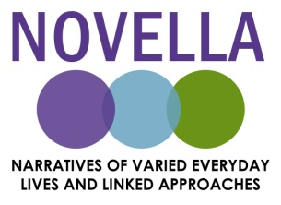

Family Lives and the Environment
  Aim: To improve understanding of the negotiated complexity of families’ lives in relationship with their environments, with regard to meanings of ‘environment’ in narratives of everyday and habitual family lives and family practices.
  Janet Boddy (University of Sussex)
  Ann Phoenix, Natasha Shukla, Catherine Walker, Helen Austerberry, Hanan Hauari and Claire Cameron (UCL Institute of Education)
  Gina Crivello, Virginia Morrow, Emma Wilson, Uma Vennam, Madhavi Latha and Renu Singh (Young Lives)

Slide 27

Methods
Secondary analysis of Young Lives qualitative data
New data collection: UK and Andhra Pradesh/Telangana
Purposive sample of eight cases
12 families per country (YP in school year 7 or 8)
Carer and young person interviews
Three rounds (YP aged 12, 13, 15 years)
Contrasting contexts
urban and rural; relative affluence
individual and family group interviews; photography; mapping; walking/driving interview
Multi-method approach
Notes:
So our project set out to address these issues, and also to challenge understandings of translatability, and directions of learning between global south and north. This was embedded in the research design – so we began by learning from Young Lives – qualitative data and qualitative methodology – working in collaboration with Prof Uma Vennam and with the Young Lives team in the UK. We then spent time doing piloting and methodological development here, and collected new data in AP before collecting data in England. So our aim in both countries is that we should be looking from the inside and the outside, and the workshops here are part of that process.

Slide 28
Taylor and Pacini-Ketchabaw (2015: 507)
‘We have been contemplating the pedagogical implications and affordances of repositioning children within the common worlds we co-inhabit and co-shape with a whole host of other species, entities and forces… In line with this shift beyond the social, or beyond the exclusively human, we …focus, instead, on the collective manners and means through which children learn from engaging with other species, entities and forces in their immediate common worlds. We call these collectively engaged modes of learning ‘common world pedagogies’.
Situates human lives as entangled with human, non-human & non-living entities: e.g. technologies, discourses & landforms.

Slide 29
Technology embedded in everyday lives for those with access
iPads, mobile phones, television sets and computers necessary for school work and socially important for friendships and leisure.
In a digital age, online and offline lives co-exist (Livingstone and Bulger 2014).
Technology as part of a ‘common world’ perspective (Affrica Taylor, 2014).
In inner London, Tamsin, Nathan’s sister, said she preferred to stay at home with her iPad than go to the local park because it lacked resources and was strewn with rubbish.

Slide 30
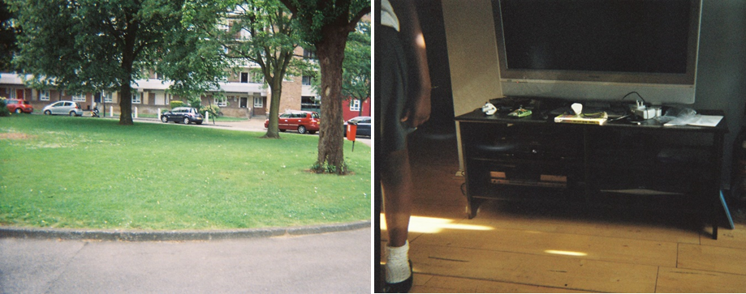
Virtual expansion of educational, material and material space of home

Slide 31
Muultiple affordances of technology: Intersections of class, generation, nation
NAGESHWAR: Morning, waking up late. Playing computer, eating lunch and then going to friends’ house. Evening uh, with my family going to uh, some other place. (urban Andhra Pradesh)
ROSIE: We do Facetime together – that’s how sad we are – we Facetime each other from our house, and it’s the weekend. And we're going to see each other the next day. (rural England, iPad bought to allow her to communicate with friends abroad following migration back to UK)
Multiple affordances (Gibson, 1977) of the iPad include enabling the continuation of school-based social life within the physical space of home.
Time-space compression (Harvey, 1989; Massey, 2005).

Slide 32
Psychosocial technological affordances Agency & constraints
INTERVIEWER: Okay. …Is there anything that you’ve learnt about at school that made you want to do something differently at home?
NAREN: Uh, I wanted to stop the use of the computers – not actually stop but lessen the use because I read this – that every – every click of the mouse, we – we give off carbon fumes… So ‘til after some time, ‘til after not even a month I have - I have not been able to stop the use of computers (softer).
AMRUTHA: (‘I only stop it’) like if we get some exams or something.
INTERVIEWER: Ok, so for all of you would you say that using computers, and using AC, like Aamir said, is part of your life?
AMRUTHA: Yeah.
JAHNAVI: Like almost every day we get like a research task, [like information … But the thing is that if I sit in front of the computer, I open Skype, then I see something else, and [then =
SANDEEP: = Facebook =
JAHNAVI: = so that’s how] we – yeah, Facebook!

Slide 33
Children convincing parents that the computer is not a marginal activity 1
Aruna [mother]: Actually this place is not just for Amrutha. [Alekhya also does a lot of, uh =
Amrutha: = It’s for all of us =
Vijay [father]: = Project work], [uuuuuh (.) = Alekhya: = Barbie games!] Vijay: Barbie games.
Alekhya: YouTube!
Vijay: YouTube.
Alekhya: Google!
(Researchers laugh)
Vijay: [Google =

Slide 34
Children convincing parents that the computer is not a marginal activity 2
Amrutha: = Email], [Facebook =
Aruna: = And even I] uh, browse. And even Vijay does some work [over there =
Amrutha: = A lot of work].
Aruna: So (.) that computer corner is for everybody.
Vijay: Yeah.
Natasha: Mmhmm, mmhmm.
Vijay: So, yeah, the more I think about it, yes it does play a big part, so (.)
Amrutha, 12, family photo discussion, Hyderabad

Slide 35
Conclusions: Wellbeing and Intersectionality
Children’s wellbeing is dependent on their positioning, which enables:
      Constrained agency
      Negative/favourable treatment by other people
State policies
Intersectionality is central to understanding young people’s practices in ‘postmigration’ Finland 3.0
Shefer et al., (2018) Engaging youth in activism…’ Recurrent theme.

Slide 36
Conclusions: Narratives of consumption essential to claiming ‘liveable lives’ (Butler, 2004)
Poverty and limited access to material resources limit young people's opportunities to take up the identities potentially available to them.
Contradictory possibilities for technology in children’s lives– utility of a ‘common world’ perspective.
Technology and everyday lives are inextricably linked, particularly for those with more material resources.
Technological affordances enable virtual expansion of home spaces and protect from outside environments.

Slide 37
Chimamanda Ngozi Adichie TED Global 2009 The danger of a single story
…What this demonstrates, I think, is how impressionable and vulnerable we are in the face of a story, particularly as children. Because all I had read were books in which characters were foreign, I had become convinced that books by their very nature had to have foreigners in them and had to be about things with which I could not personally identify.
Now, things changed when I discovered African books…. I realized that people like me, girls with skin the color of chocolate, whose kinky hair could not form ponytails, could also exist in literature. I started to write about things I recognized.
Now, I loved those American and British books I read. They stirred my imagination. They opened up new worlds for me. But the unintended consequence was that I did not know that people like me could exist in literature. So what the discovery of African writers did for me was this: It saved me from having a single story of what books are.
Importance of polyphony and understanding of multiplicity and complexity for holistic understanding of failing identities.

