Slide 1
Nicole Valentine, KC Tang
WHO (Geneva)
The Manual's Development in the broader context of HiAP and the social determinants of health

Slide 2
Overview
Historical overview
  Social determinants and intersectoral action
  Social Determinants and Rio
  UN political declaration on NCDs
  NCDs and SDH
  Action across sectors
  Training manual
Skills training and capacity
  Dialogue and debate
  Evidence for practice
Towards a Master Global Plan for Training

Slide 3
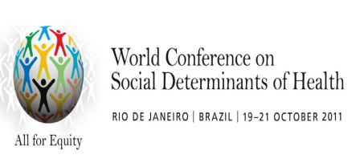
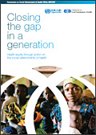


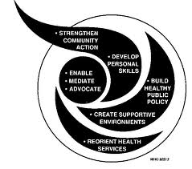
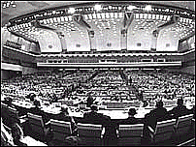

Global mandates –
History to current day
2011
2014 WHA Resolution
2008
2013 Global Conference on Health Promotion
2006
2011
Rio Political Declaration on Social Determinants of Health
1997
2008 Report of the Commission Social Determinants of Health
1988
C-PHC S-PHC Reforms & Minimum Packages MDG Scaling-up Equity and SDH NCDs post-2015
2006
Finnish Presidency of the European Union in 2006, Health in All Policies (HiAP)
2011
UN Political Declaration on NCDs
1986
1997
Intersectoral Action
for Health- a
cornerstone for health for all in the 21st century
2009
WHA Resolution Reducing Health Inequities Through Action on the Social Determinants of Health
1978
1986
World Health Organization’s Ottawa Charter for Health Promotion
1948
1999 The Gothenburg consensus Paper on Health Impact Assesment
1978
Alma-Ata Declaration Health for All agenda (1970s), action falters in 1980s
Social dimensions of health affirmed in WHO Constitution (1948), downplayed during 1950s era of disease campaigns
1988
Adelaide Recommendation on Health Public Policy
Notes:
Ideological shifts:
70s – Decade of development: consensus on health and development
80s – “Lost Decade”, proliferation of strategies: selective PHC vs. integrated health care, district health systems and Healthy Cities
90s – Decade of Reform & Globalization: efficiency of bureaucracy and introduction of market economies in health sector; also the Water Decade and the "Washington Consensus” – IMF-WB-WTO
New influence of stakeholders:
UNICEF – selective application of PHC, 1979, then moved to children's rights, 1995
WB – redefines measurements of health: WDR 93 Investing in Health
UNDP – introduces country strategy note & includes PHC. Effort for better UN coordination, MDGs
USAID – emphasizes civil society and quality
New health discipline:
Health economics introduces new ways of measuring resources and health achievements, influencing design of health systems financing and efficiency measures
National budgets for health:
Increase as % of GDP
Decrease in equitable distribution

Slide 4
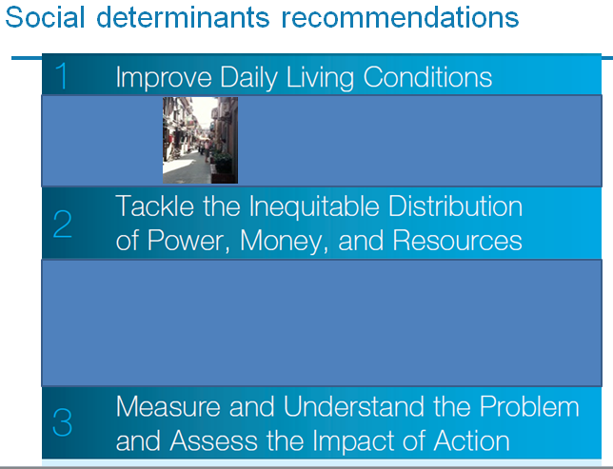




Commission on Social Determinants of Health
Inequalities are killing on a grand scale…
The circumstances in which people are born, grow up, live, work and age, and the systems in place to deal with illness.
These circumstances are shaped by a wider set of forces: economics, social policies, and politics (health system, one force).
Largely responsible for
health inequities.

Slide 5
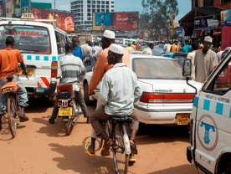
Definitions
Intersectoral action:
The process in which the objectives, strategies, activities and resources of each sector are considered in terms of their implications and impact on objectives, strategies, activities and resources of other sectors.
Health equity:
The absence of unfair and avoidable or remediable differences in health among groups defined socially, economically, demographically or geographically.
Population health interventions:
Aim to change the social context that influences health (Rose in Frohlich, 2014)
Notes:
HiAP an Enabler for Public Health and Health Equity

Slide 6

The Rio Declaration
Action areas:
To adopt better governance for health and development
To promote participation in policy-making and implementation
To further orient the health sector towards reducing health inequities
To strengthen global governance and collaboration
To monitor progress and increase accountability

Slide 7
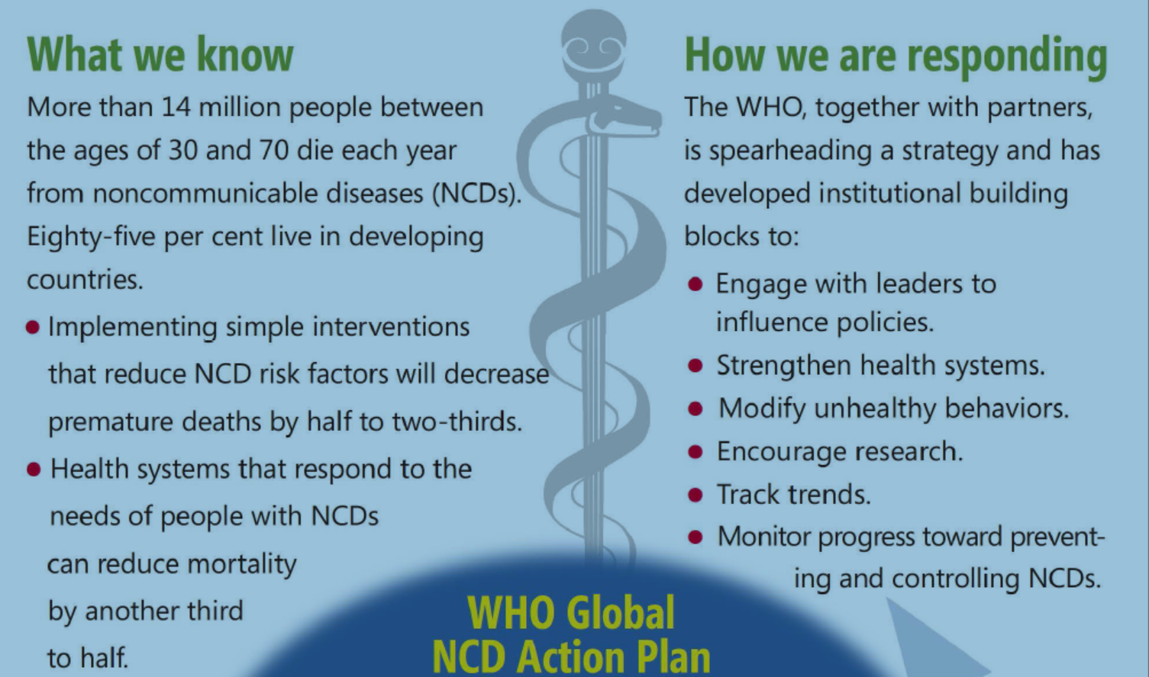
UN Political Declaration on NCDs
Notes:
Noncommunicable diseases (NCDs) are the leading causes of death and were
responsible for 38 million (68%) of the world’s 56 million deaths in 2012 (1). More
than 40% of those deaths (16 million) were premature (i.e. under the age of 70 years).
Almost three quarters of all NCD deaths (28 million), and the majority of premature
deaths (82%), occurred in low- and middle-income countries. Modifiable risk factors
such as poor diet and physical inactivity are some of the most common causes of
NCDs; they are also risk factors for obesity1 – an independent risk factor for many
NCDs – which is also rapidly increasing globally (2). A high level of free sugars2 intake
is of concern, because of its association with poor dietary quality, obesity and risk of
NCDs (3, 4).

Slide 8
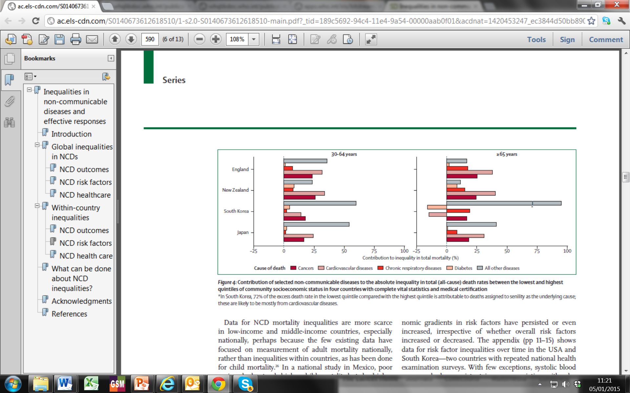
Post 2015: NCDs
Enhancement and improvement of early childhood development programs and education for all social groups
Removal of barriers to secure employment
Taxation of tobacco and alcohol,regulation of their production and sales, and restriction of advertising and marketing of these products
Reduction of dietary salt intake by regulation, well-designed, targeted public education etc.
Improvement of financial and physical access of disadvantaged to healthier diets (subsidies, agricultural policies, regulations)
Inequalities in non-communicable diseases and effective responses; The Lancet NCD Action Group; February 2013, The Lancet

Slide 9
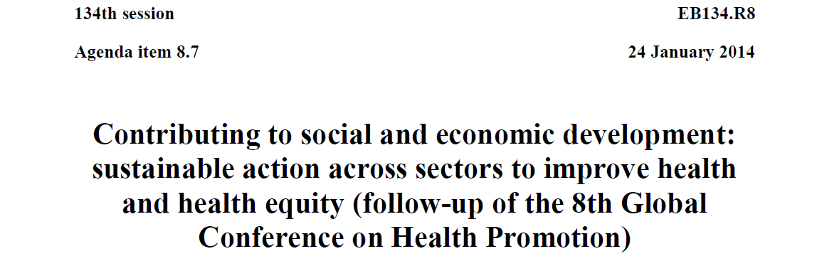
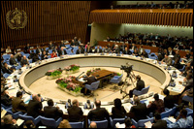
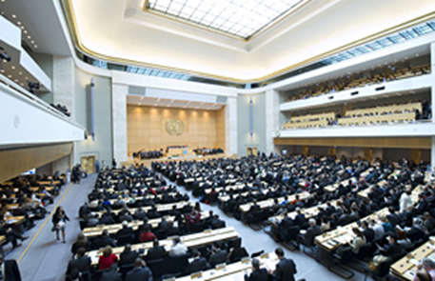
134th Session of the Executive Board in January 2014
Report prepared by the Secretariat and presented to EB 134
67th Session of the WHA, May 2014 Adopts resolution 67.12

Slide 10
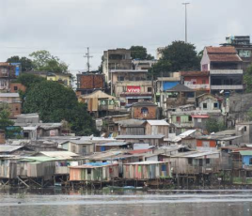
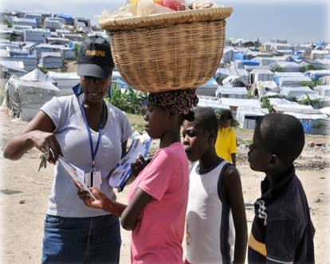
Global mandates on intersectoral action and
Health in All Policies (HiAP)
“An approach to public policies across sectors that systematically takes into account the health implications of decisions, seeks synergies, and avoids harmful health impacts in order to improve population health and health equity”
2013 Helsinki Statement on Health in All Polices
Notes:
Founded on rights and obligations
Improves the accountability for health impacts at all levels of policy making
Emphasis on the consequences of public policies for health care/systems
Contributes to sustainable development

Slide 11
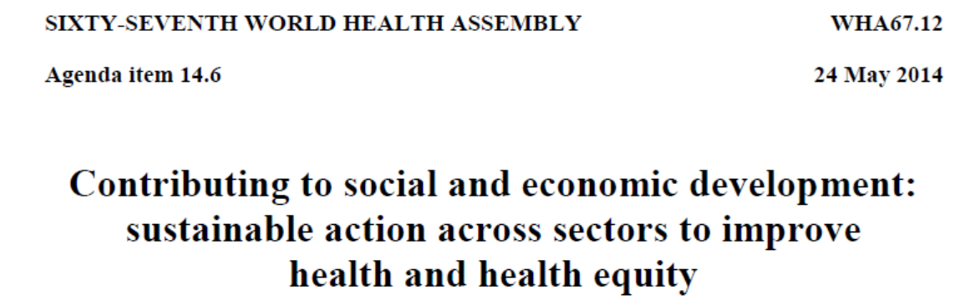
Framework for Country Action Across Sectors
Follow-up to the World Health Assembly Resolution 67.12 – Contributing to social and economic development
  Framework for Country Action Across Sectors for Health and Health Equity
  REQUESTS the WHO Director-General: to prepare a “Framework for country action across sectors for health and health equity”
  Putting action across sectors into practice- training courses

Slide 12
1. Development of Framework for country action across sectors for health and health equity
A discussion paper was developed and posted on the web from October to December 2014 for comments
( only 15 submissions received)
Technical reference group (one expert per WHO region) will meet on 5-6 March 2015 to discuss latest comments and provide final recommendations
First draft has been posted again on the web and is open for comments until 3 March 2015.
Second Draft will be put together by the Secretariat based on the input from the Technical Reference Group by end of March 2015. Presented to WHA in May 2015
First Draft of the Framework has been developed by the Secretariat based on the Discussion Paper and comments received
Now!
Notes:
The technical reference group will meet next week. It will be chaired by Finland and WHO PND

Slide 13
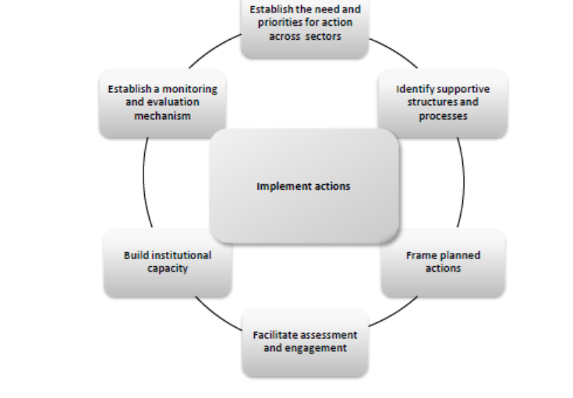
Country Action

Slide 14
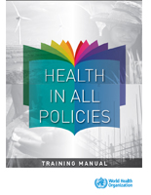


Slide 15
Skills training and capacity
Dialogue and debate about practice
  Action:SDH discussion forums
  Supporting regional positions on HIAP, an equity focus
Evidence
  On interlinkages between sectors (Sectoral Series)
  Economic evaluation
  Intersectoral Action Case Study Database

Slide 16
Towards a Master Global Plan for Training in Working Across Sectors (for discussion)
Dissemination, advocacy and demand generation in national governments
Supporting networks of institutions/trainers to deliver the training
Conducting regional and country trainings
Creating a database of resources and generating new materials – supporting communities of practice
Actively supporting course adaptation
Resourcing: active fund raising

Slide 17
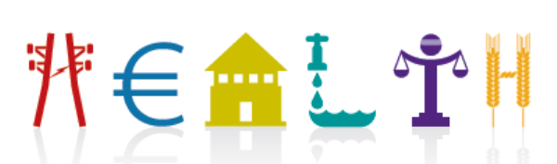
Gracias! Merci! Thank you!

