Slide 1
HIAP Indepth Briefing Slides
Ilona Kickbusch

Slide 2
WHO HIAP Training Manual
Introduction to the determinants of health
21st century health dynamics and inequalities
Health in All Policies
The policy making process
Role of government in WOG approches
Preparing policy briefs
Role of non-governmental stakeholders in HIAP/WOS approaches
Negotiating for health
Implementation at different levels
Measuring progress in health
Leadership role of the health sector in HiAP
Next steps and round up

Slide 3
Health: Complex policy problem
Recognition that public health policy needs new approaches in order to be able to address very complex policy problems.
Assess uncertainty
Assess levels of agreement
Assess spread of knowledge and capacity
Prioritize iterative learning processes
Incentivize intelligent risk taking

Slide 4

HIAP Skills
Solution seeking mindset
Invent options for mutual gain
Focus on interests not positions
High levels of inter personal and organisational sensitivity
To deal with differences and manage difficult trade offs
Capacity to acknowledge others contribution
Give credit where it is due
Be generous

Slide 5
Teasers
Dynamics and complexity
Framing
Whole of government
Collective impact
Mutual gain, Negotiation, health diplomacy

Slide 6
Dynamics and complexity

Slide 7
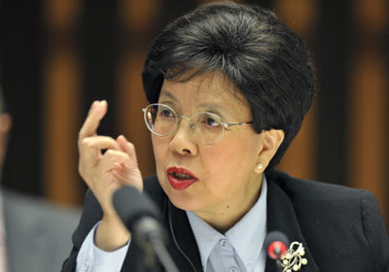
21st century dynamics: Starting point
The challenges facing public health, and the broader world context in which we struggle, have become too numerous and too complex for a business as usual approach.
Margaret Chan, DG WHO

Slide 8
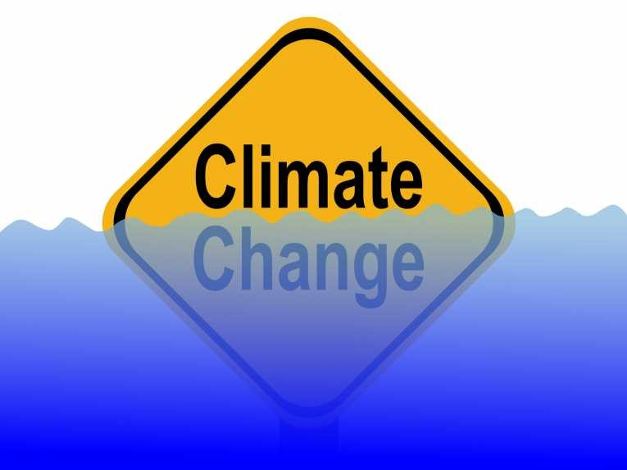


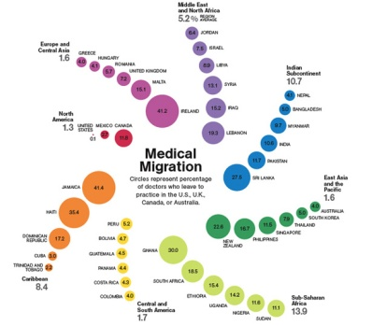
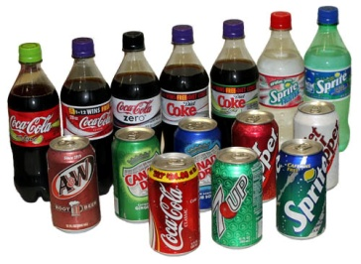
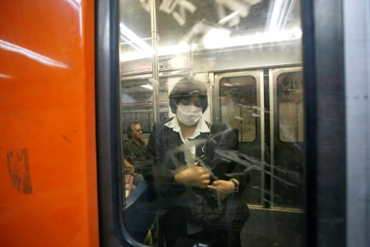

GLOCAL: Trans-boundary collective action
Trade
Mobility/Migration
Environment
Infectious disease
Intellectual property
Food/soda
Disaster response
Global Crime
Terrorism
Knowledge
High degree of uncertainty
High degree of interconnectedness
Need for collective action

Slide 9
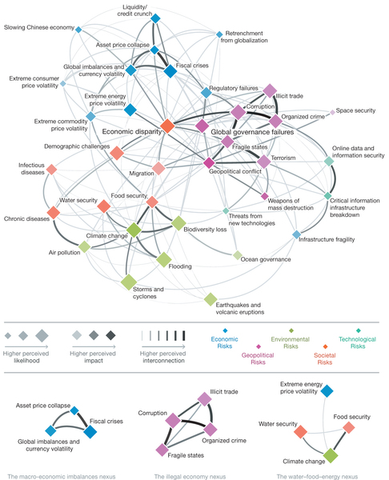
Interconnectedness
Interconnectedness of issues and of governance levels

Slide 10
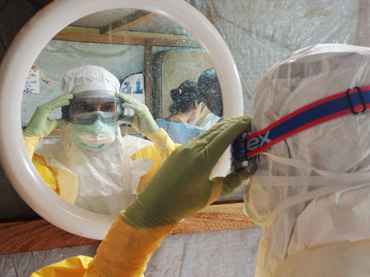
Rise of systemic risk
Systemic risk is the risk of “breakdowns in an entire system, as opposed to breakdowns in individual parts and components”.
Systemic risks are characterized by:
modest tipping points combining indirectly to produce large failures
risk-sharing or contagion, as one loss triggers a chain of others
“hysteresis”, or systems being unable to recover equilibrium after a shock
(World Economic Forum)

Slide 11
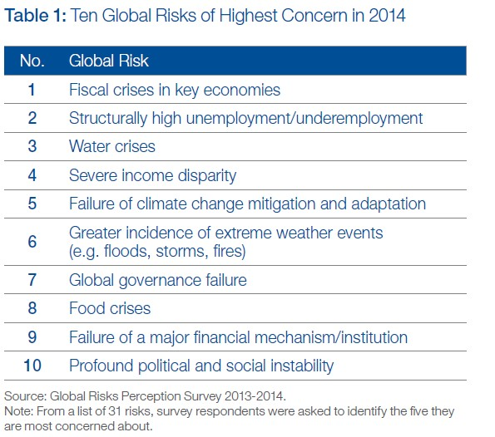
Core set of risks
Economic risks
Environmental risks
Geopolitical risks
Societal risks
Technological risks

Slide 12
Societal Risks
The societal category captures risks related to social stability – such as severe income disparities, food crises and dysfunctional cities – and public health, such as pandemics, antibiotic-resistant bacteria and the rising burden of chronic disease

Slide 13
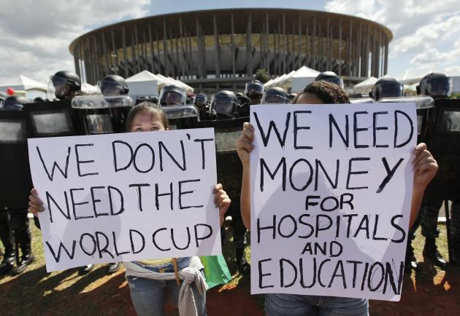
Growing disparity a political risk

Slide 14
Complexity
The complexity of these problems require systems approaches and networked responses at all levels and force policy makers to move beyond silos.
Wicked problems require innovative, comprehensive solutions that can be modified in the light of experience and on-the-ground feedback.
The solution depends on how the problem is framed and vice-versa (i.e. the problem definition depends on the solution)

Slide 15
Framing

Slide 16
Health
Preferred frame:
Health is a precondition, outcome, and indicator of a sustainable society
Health is a social goal of governments

Slide 17
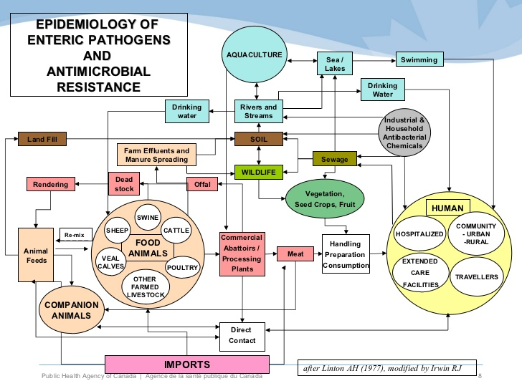
Anti microbial resistance

Slide 18
WHO Health Security Framing 2007
Emerging diseases
Economic stability
Chemical, radioactive and biological terror threats
HIV AIDS a key health and security issue
Building health security
International crisis and humanitarian emergencies
Environmental change
Strengthening health systems

Slide 19
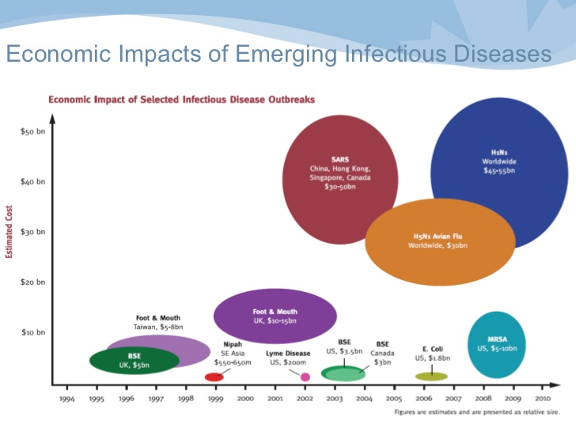
Economic framing

Slide 20
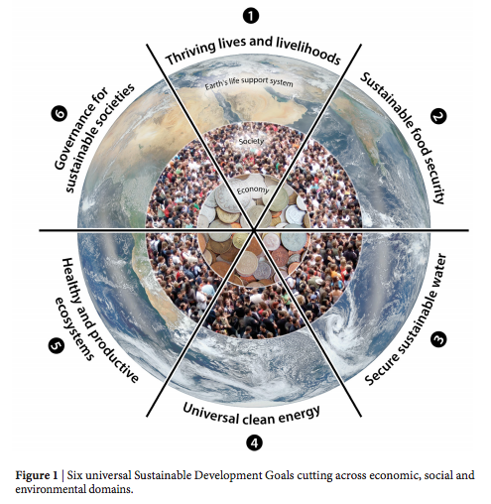
Sustainability Framing

Slide 21
Determinants framing
political
environmental
economic
behavioural
commercial
social

Slide 22
New frames: PDOH // CDOH
The power constellations and ideological positions that impact on health
  - Promoting consumption at the expense of health and wellbeing
Kickbusch 2014

Slide 23
Whole of Government

Slide 24
Public issues have become more complex and multi dimensional
One way of coping with this development: whole of government collaboration
Learning, communication, analysis and decision making processes must take place across organisational boundaries

Slide 25
WOG
  Whole of government –
  what does it mean?
Health is a precondition, outcome, and indicator of a sustainable society
Health is a social goal of governments

Slide 26
Wicked problems pose new governance challenges
Wicked problems are socially defined - so getting the “whole system in the room” to enable people to learn from one another is both useful and necessary.
Social learning is more likely to be successful if it evolves as stakeholders meet, interact, and inform one another’s actions.

Slide 27
Pros and cons?
In 21st century governance there are two central elements to consider: efficiency and legitimacy. Both have been driving forces for multi-stakeholder processes and are central in any HIAP process.
A comprehensive multi-stakeholder process can give a high legitimacy to an initiative, but it also entails significant transaction costs. The more stakeholders at the table, the more difficult and time-consuming the process can be to come to a common understanding and position.

Slide 28
To the public, the government is one whole
Think citizens need/public value not agency priorities
Do not forget overarching goal

Slide 29
GOAL
Multiply effort to create public value through a connected and collaborative government
Benefits that accrue to the whole of government
„one government“

Slide 30
Governance
“The sum of the many ways individuals and institutions, public and private, manage their common affairs.
It is a continuing process through which conflicting or diverse interests may be accommodated and cooperative action may be taken. It includes formal institutions and regimes empowered to enforce compliance, as well as informal arrangements that people and institutions either have agreed to or perceive to be in their interest.”
(The Commission in Global Governance, 1995)

Slide 31
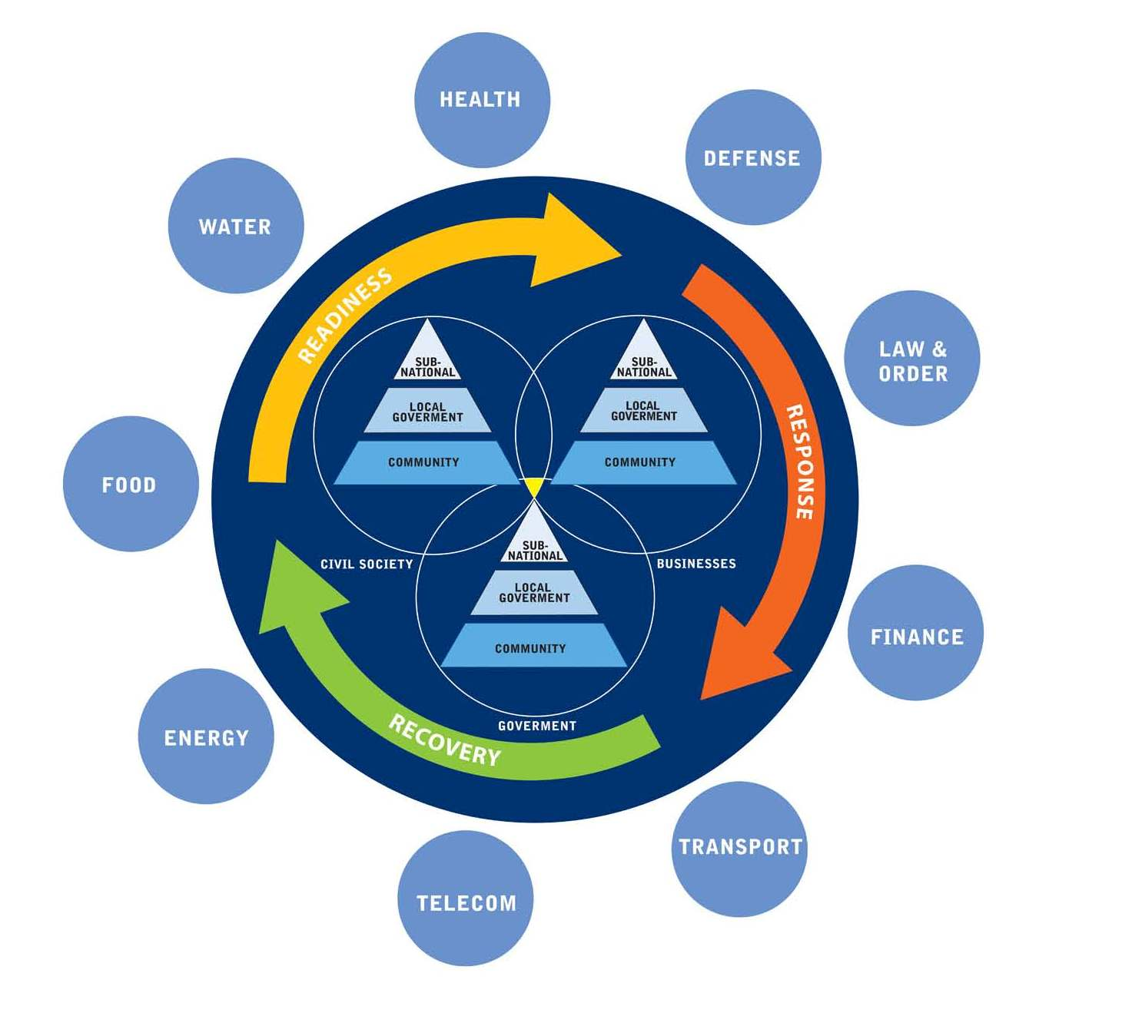
Pandemic response

Slide 32
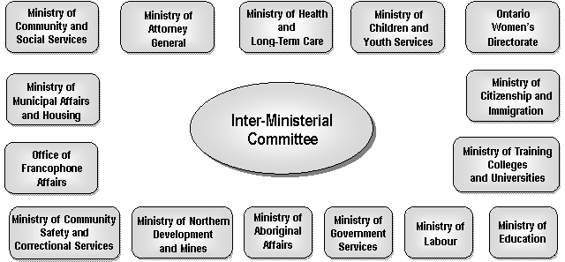
Domestic Violence

Slide 33
Common characteristics of a whole of government approach
DIRECTION: it implies a long-term strategic focus, working towards shared goals of government or within a joint political framework of cross-cutting targets
STRUCTURE: it is built on a conscious and an organizational design or reorganization to support ministries and government organizations to work better together to achieve an integrated policy response
CULTURE: it requires a cultural change within the administration and in policy making: values, leadership, processes, working practices and attitudes must be addressed.
ACCOUNTABILITY: it aims to introduce shared responsibility and balance vertical and horizontal accountability as well as transparency and responsiveness towards citizens

Slide 34
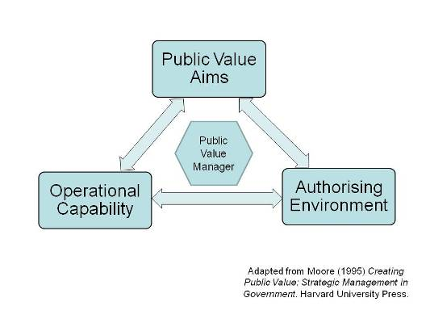
Strategic triangle

Slide 35
Collective impact
Mutual gain
Negotiation – health diplomacy

Slide 36
Health Diplomacy
Negotiating for health in the face of other interests
Building relationships and alliances for health outcomes and addressing health determinants
creating opportunities for mutual gain

Slide 37
Negotiation
For a whole-of-government approach, this means negotiating across to achieve national
policy coherence:
for a whole-of-society approach, this means negotiating out to build coalitions with diverse actors
In addition, “negotiating up” can imply convincing high-level decision-makers

Slide 38
Create a social // political space
1. Identify several initial domains for action as lever points for change – visualize relationship (tactical mapping).
2. Assemble around each lever point a strategic network of key stakeholders from the government, business sector and civil society. All assembled organizations must be willing to invest time, expertise, core competencies and financial resources to achieve the goal set by this respective network: network analysis/ stakeholder analysis
3. Bring together all the networks created according to the lever points within a whole-of-society compact that is supported by a platform to share information and research and build capacity. Create social spaces – structured conversations

Slide 39
Assess action space
Contextual environment
Transactional environment
Policy space
Organisational space

Slide 40
Collective impact
„committment of a group of important actors from different sectors to a common agenda for solving a specific social problem“
A common agenda
Shared measurement systems
Mutually reinforcing activities
Continuous communication
Back bone support organisations

Slide 41
Co benefits – mutual gain
Understand context
Build relationships – build trust - be flexible
Assume good intentions
Create reciprocity – share – give credit
Discover shared values
Create common language
Harmonize policy goals

Slide 42
The four step Mutual Gains Approach
Preparation
Prepare by understanding interests and alternatives.
Value Creation
Create value by inventing without committing. Based on the interests uncovered or shared, parties should declare a period of “inventing without committing” during which they advance options by asking “what if…?” By floating different options and “packages” —bundles of options across issues—parties can discover additional interests, create options that had not previously been imagined, and generate opportunities for joint gain by trading across issues they value differently
Value Distribution
Follow Through

Slide 43
Health impact – active transport
 | Change in disease burden | Change in premature deaths
Cardiovascular Dis. | 6-15% | 724-1895*
Diabetes | 6-15% | 73-189
Depression | 2-6% | <2
Dementia | 3-10% | 63-218
Breast cancer | 2-5% | 15-48
Colon Cancer | 2-6% | 17-53
Road traffic crashes | 10-19% | 60-113
* Range reflects range of physical activity in scenarios

Slide 44
Four critical considerations:
a range of trade offs
a tolerance for ambiguity and of uncertainty.
An opportunities driven approach
a good contextual analysis:
  the contextual environment: factors in the external world which impact the issue but cannot be influenced by the organization
  the transactional environment: factors that are external to the organization but can be influenced by that organization
  the policy or strategy space: the internal world of an organization or system which can be controlled

Slide 45
Political determinants
“The key point is that, while policy-making is a process, it is also a human endeavor and as such it is not based on objective and neutral standards. Behind every step in the policy process is a contest over equally plausible conceptions of the same abstract goal or value. Remember, those participating in policymaking are also driven by their belief systems and ideology. These values and ideologies precede and shape the decisions along every step of the policy process.”
(FrameWorks Institute, 2002)

Slide 46
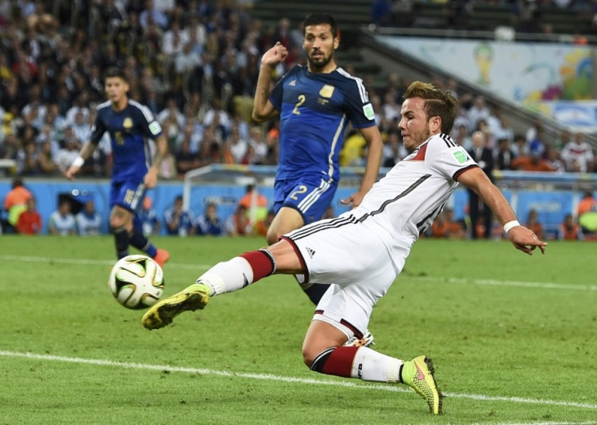
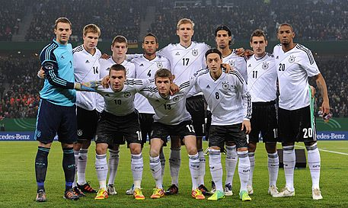
Learn from the World CUP?

